Slide 1
Econ 200 Module 2 Lecture 2

Slide 2
Outline
Gains from Trade and Production Decisions
Markets and Demand Curves
Changes in Demand
Readings: Chapter 2.4, Chapter 3.1-3.3

Slide 3

Class Administration
Weekly class schedule

Slide 4
Who produces which goods and why?
People around the globe coordinate production activities to sell to consumers what they want.
The global production is a natural outcome of people everywhere acting in their own self-interest to improve their own lives.
Economists call this coordination mechanism the invisible hand.
Notes:
There are several examples of gains from specialization (and trade). One typical example is the bread maker. The bread maker produces large quantities of dough and keeps the oven hot. The bread maker has racks for cooling multiple loaves and sells fresh bread daily. “It is not by the benevolence of the bread maker that society receives bread. Rather, it is his/her self-interest to obtain money to buy other goods does the baker produce as much bread as possible and use his/her resources as efficiently as possible to reduce the cost of production.” Adam Smith, Wealth of Nations. If everyone is self-interested, they will produce goods and services that individuals want. They will also gain expertise in producing goods by specializing in the production of a particular good or service. By their own greed, they will desire to minimize the costs of producing these goods to obtain the largest gain from selling them. One can imagine individuals moving around producing goods for each other without expressly being told what to produce. This is the invisible hand. Production does not have to be coordinated by a central organizer (social planner) nor do goods and services accidentally get produced. They are all produced for a specific group of people in mind.

Slide 5
Absolute and Comparative Advantage
Can view the PPF as the key trade-offs faced by one economy.
If there is no trade between economies, then what a country produces is what it consumes.
Using PPFs, we can understand how countries decide what to produce.

Slide 6
Absolute and Comparative Advantage
Suppose that an American worker can produce 50 shirts or 200 bushels of wheat per day. A Bangladeshi worker can produce only 25 shirts or 50 bushels of wheat.
The U.S. has an absolute advantage in shirt production since a U.S. worker can produce more shirts than a Bangladeshi worker.
The U.S. has an absolute advantage in wheat production since a U.S. worker can produce more wheat than a Bangladeshi worker.
But absolute advantage does not reflect the tradeoffs inherent in production and so is not a good guide for which countries can produce which goods most efficiently.
 | Wheat (bushels/worker/day) | T-shirts (bushels/worker/day)
United States | 200 | 50
Bangladesh | 50 | 25

Slide 7
Absolute and Comparative Advantage
To understand how each country decides which good to produce when they interact, the opportunity costs are calculated:
U.S.: 1 shirt costs 4 bushels of wheat.
Bangladesh: 1 shirt costs 2 bushels of wheat.
Using the reciprocal of the above opportunity costs:
U.S.: 1 bushel of wheat costs 1/4 shirt.
Bangladesh: 1 bushel of wheat costs 1/2 shirt.

Slide 8
Absolute and Comparative Advantage
A country has a comparative advantage in a good if it can produce it at a lower opportunity cost than other countries.
U.S. has a comparative advantage in wheat production over Bangladesh.
Bangladesh has a comparative advantage in shirt production over the U.S.
No country has a comparative advantage in everything, and each country has a comparative advantage in producing something.

Slide 9
Why specialize?
Suppose the US has 150 M. workers and Bangladesh has 80 M.
In isolation, each country produces and consumes on its own.
U.S. produces 1 B. shirts and 26 B. bushels of wheat.
Bangladesh produces 0.5 B. shirts and 3 B. bushels of wheat.
Wheat
T
-shirts
Country
(billions of bushels)
(billions)
United States
26
1
Without specialization
Bangladesh
3
0.5
Total
29
1.5
United States
30
0
With specialization
Bangladesh
0
2
Total
30
2
Notes:
The table in the text has bundled many computations. Please note the following:
Without specialization implies producing in isolation and ignoring comparative advantage and opportunity cost.
With specialization implies producing the good for which the country has a comparative advantage.
U.S.: 30 billion bushels of wheat = 150 million workers × 200 bushels of wheat per worker. 0 t-shirts.
Bangladesh: 2 billion t-shirts = 80 million workers × 20 billion shirts. 0 bushels of wheat.
The gain from trade is 0.5 billion t-shirts. How each country receives the gain is determined by the terms of trade.

Slide 10
Why specialize?
If each country specializes, total production increases. In that case, all U.S. workers produce wheat and all Bangladeshi workers produce shirts. Then the countries can trade wheat for t-shirts.
Wheat
T
-shirts
Country
(billions of bushels)
(billions)
United States
26
1
Without specialization
Bangladesh
3
0.5
Total
29
1.5
United States
30
0
With specialization
Bangladesh
0
2
Total
30
2
With specialization, more of everything is produced because the producers with the lowest costs produce each good. These are the gains from specialization and trade.
Notes:
The table in the text has bundled many computations. Please note the following:
Without specialization implies producing in isolation and ignoring comparative advantage and opportunity cost.
With specialization implies producing the good for which the country has a comparative advantage.
U.S.: 30 billion bushels of wheat = 150 million workers × 200 bushels of wheat per worker. 0 t-shirts.
Bangladesh: 2 billion t-shirts = 80 million workers × 20 billion shirts. 0 bushels of wheat.
The gain from trade is 0.5 billion t-shirts. How each country receives the gain is determined by the terms of trade.

Slide 11
Gains from Trade
The improvement in outcomes that occurs when specialized producers exchange goods and services is called the gains from trade.
Wheat
(B. of bu.)
Wheat
(B. of bu.)
United States’ gains from trade
Bangladesh’s gains from trade
4
3.5
With trade:
Without trade:
Production and consumption
Consumption possibilities increases
30
3
26
Without trade:
Production and consumption
With trade:
Consumption possibilities
2
20
increase
10
PPF
PPF
0
1
7.5
8
0
0.5
1
2
Billions of T-shirts
Billions of T-shirts
With specialized production, consumption is outside of the PPF.
Notes:
Gaines from trade:
U.S. and Bangladesh both gain 0.5 B. bu. of wheat.
U.S. also gains 0.5 B. T-shirts by trading 0.5 B. bu. of wheat produced in the US for 0.5 B. t-shirts produced in Bangladesh.

Slide 12
Summary
Specialization and trade can make everyone better off.
An economy is driven by individuals seeking to make a profit; people specialize so as to exploit their comparative advantages.
This principle is as true for countries, like the United States and Bangladesh, as it is for individuals transacting with each other in the market place.

Slide 13
Considerations for Designing an Economy
-What goods and services are produced?
Firms/governments/individuals must decide this while considering the trade-offs and opportunity costs of their choices.
-How are goods and services produced?
A firm might have several different methods for producing the same item.
-Who will receive the goods and services?
By income? By a principle of equity?

Slide 14
Types of Economies
Centrally planned economies - Governments decide what to produce, how to produce it, and who received the goods and services.
Market economies – Households and firms make these decisions with prices and markets as the deciding force.
Market: A group of buyers and sellers of a good or service and the institution or arrangement by which they come together to trade

Slide 15
Ch 3: Markets
A market refers to the buyers and sellers who trade a particular good or service.
Markets can be located locally, globally, or even virtually.
One special class of markets is the perfectly competitive market.
Four characteristics of perfectly competitive markets.
In this chapter, markets are assumed to be perfectly competitive.
Standardized good | No transaction costs
Full information | Participants are price takers
Notes:
It is important to emphasize that the market concept studies groups of individuals (suppliers and demanders) and indirectly the good or service of interest. In addition, market scope can include a few or lots of individuals, all depending on the analysis of interest. The idea of market boundaries may be confusing to students. It is suggested that only well-established markets with clear boundaries be discussed. The competitive market assumption is the largest assumption of this chapter and simplifies the analysis.
Standardized good:
A standardized good is any two units of the good have the same features and are interchangeable. An example of a standardized good is unleaded 86 octane gasoline. A violation of a standardized good is the ethanol in gasoline at some stations.
Full information:
Assumes market participants know everything about the price and features of the good. An example of full information is retail gasoline prices. A violation of full information is when sellers do not disclose proprietary ingredients such as fuel additives (or KFC’s secret herbs and spices).
No transaction costs:
There is no cost to participating in exchanges in the market. An example of no transaction costs is retail gasoline stations are near each other. An example of a violation of no transaction costs is when there are entrance fee to purchase from a particular seller (e.g. Sam’s club or Costco).
Participants are price takers:
Neither buyers nor sellers have the power to affect the market price. An example of price taking is that retail gasoline stations at same intersection typically have same price. A violation of price taking is a limited number of sellers that are geographically isolated, name brand vs. generic prescription drugs, and loyalty discounts.

Slide 16
Efficiency of Economies
Market economies promote:
Productive efficiency - Goods or services are produced at the lowest possible cost
Allocative efficiency - The marginal benefit of production is equal to its marginal cost
→Production is consistent with consumer preferences

Slide 17
Caveats About Market Economies
Markets may not result in fully efficient outcomes. For example:
Governments might interfere with market outcomes
Market outcomes might ignore the desires of people who are not involved in transactions – ex: pollution
Plus, markets may result in high inequality; some people prefer more equity, i.e. fairer distribution of economic benefits.

Slide 18
The Interaction of Demand and Supply
How do markets “decide” how much of a good or service to produce?
Can we generalize the notion of the trade-offs involved in every production decision?
Notes:
Households and firms are linked together in
a circular flow of production, income, and
spending. The blue arrows show the flow of
the factors of production. In factor markets,
households supply labor, entrepreneurial
ability, and other factors of production to
firms. Firms use these factors of production
to make goods and services that they supply
to households in product markets. The red
arrows show the flow of goods and services
from firms to households. The green arrows
show the flow of funds. In factor markets,
households receive wages and other payments
from firms in exchange for supplying
the factors of production. Households use
these wages and other payments to purchase
goods and services from firms in product
markets. Firms sell goods and services to
households in product markets, and they
use the funds to purchase the factors of production
from households in factor markets.

Slide 19
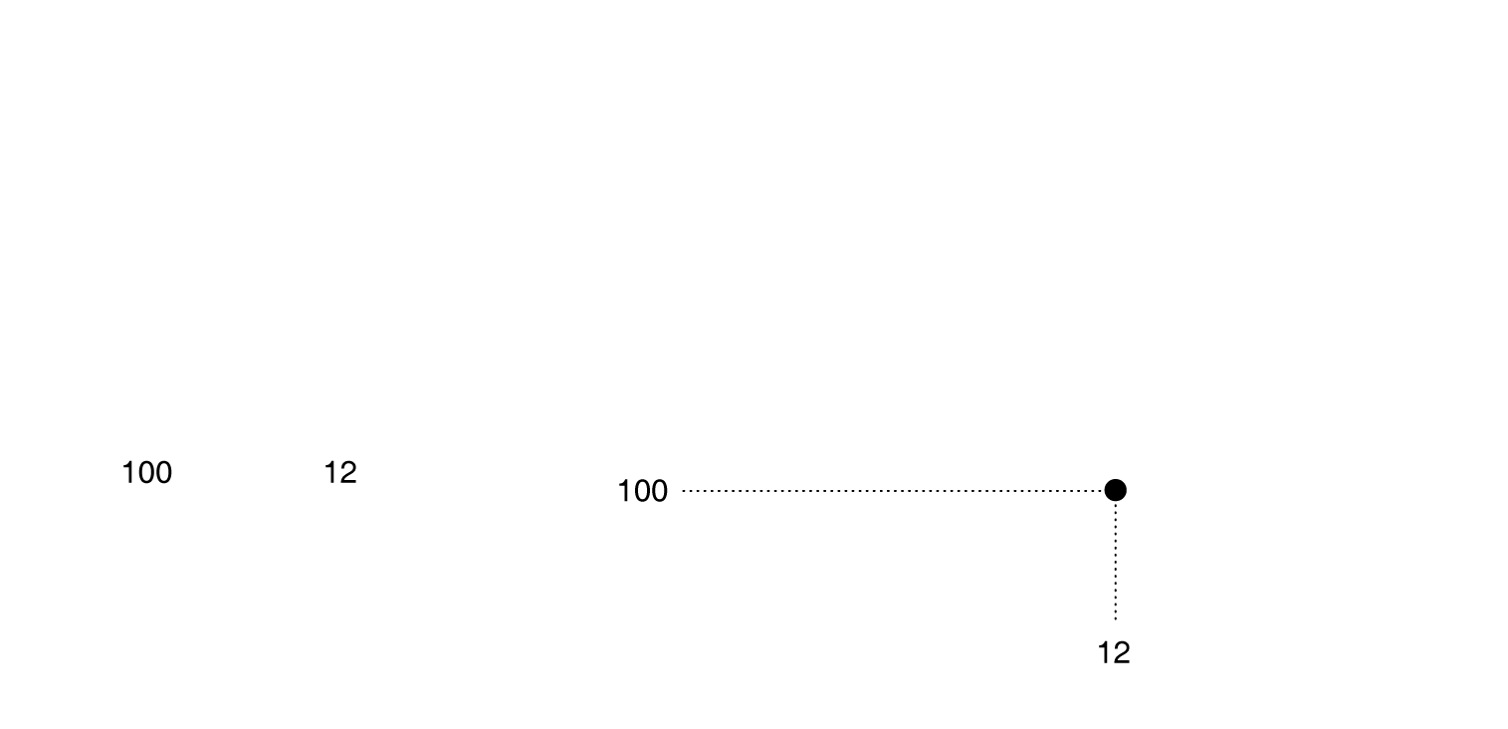
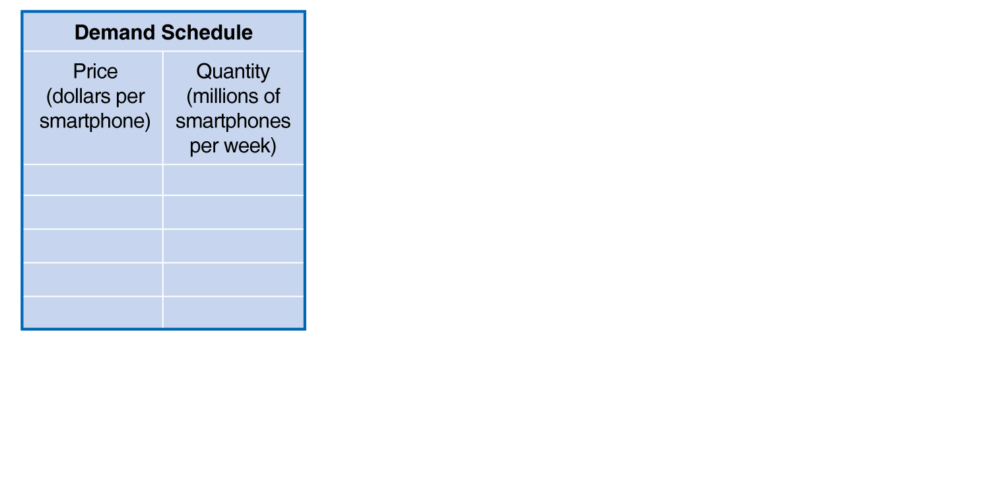
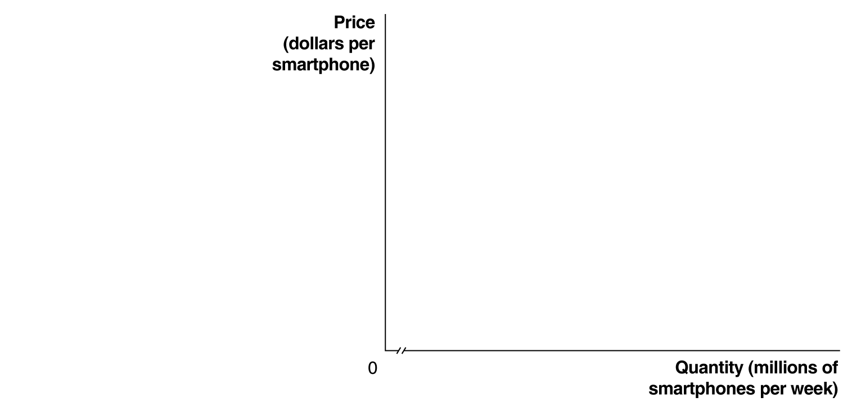
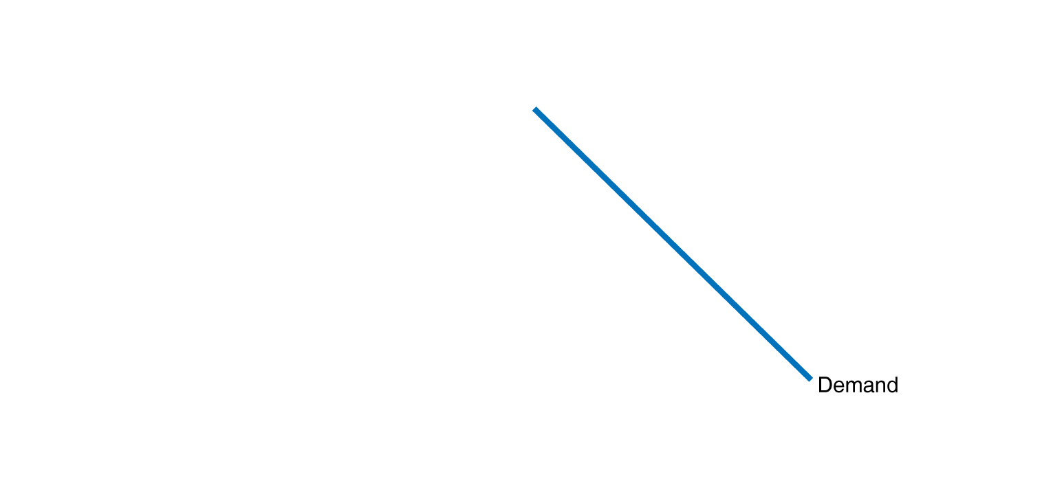
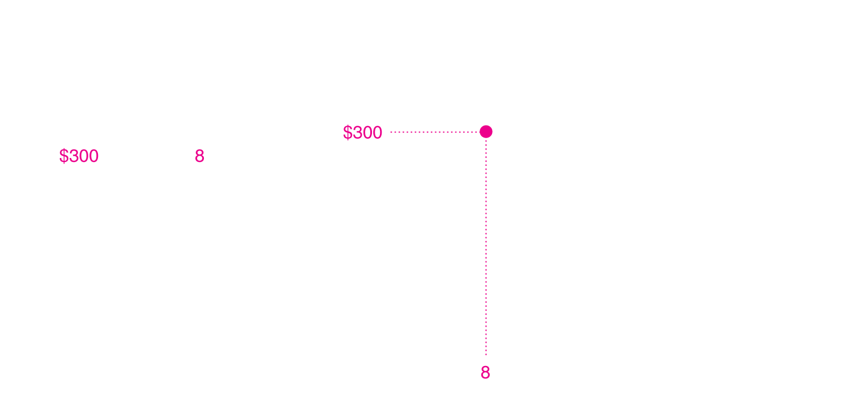
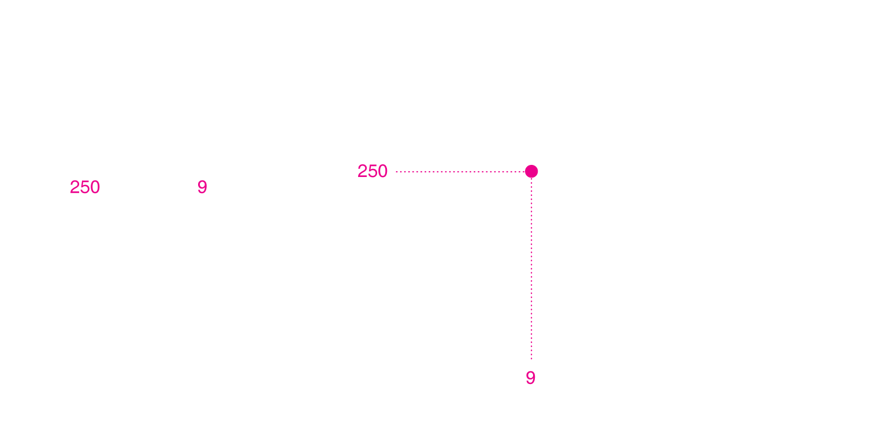
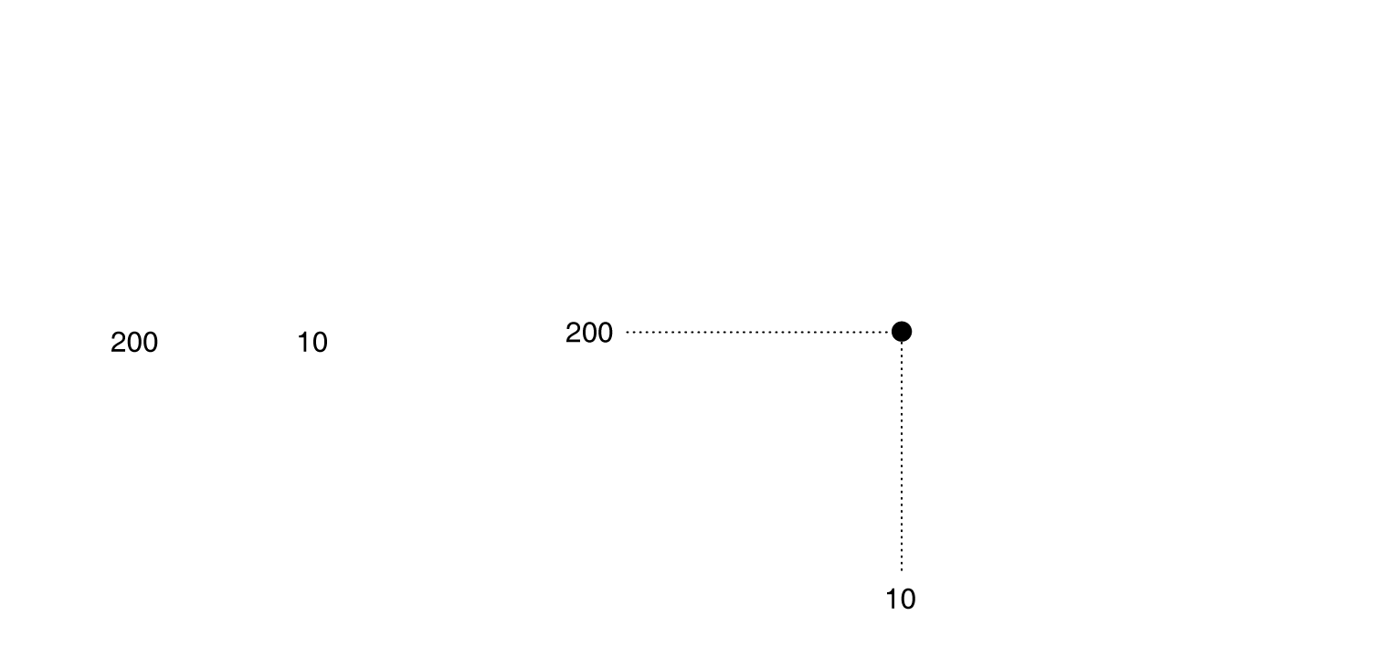
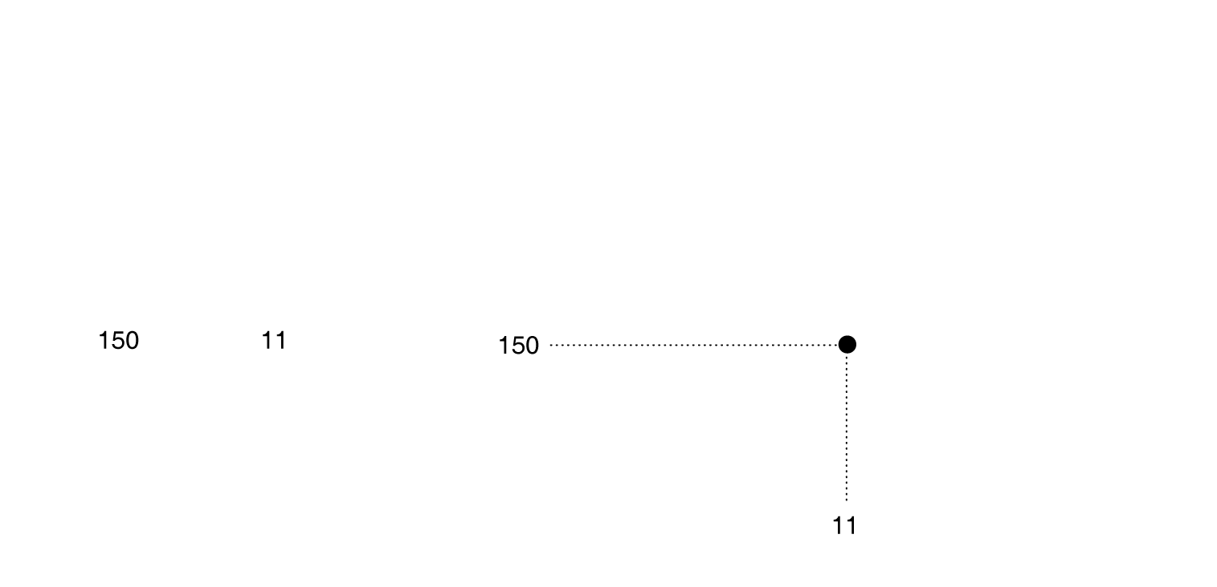
Demand Schedules and Quantity Demanded
Demand schedule: A table that shows the relationship between the price of a product and the quantity of the product demanded.
Demand curve: A curve that shows the relationship between the price of a product and the quantity of the product demanded.
A demand schedule and a demand curve
Notes:
As the price changes, consumers change
the quantity of smartphones they are willing
to buy. We can show this as a demand
schedule in a table or as a demand curve
on a graph. The table and graph both show
that as the price of smartphones falls, the
quantity demanded increases. When the
price of smartphones is $300, consumers
buy 8 million smartphones per week.
When the price falls to $250, consumers buy
9 million. Therefore, the demand curve for
smartphones is downward sloping.

Slide 20
Demand Curve and Market Demand
Quantity demanded: The amount of a good or service that a consumer (or market of consumers) is willing and able to purchase at a given price.
Market demand: the demand by all the consumers of a given good or service.
A demand schedule and a demand curve

Slide 21
Ceteris Paribus
When drawing the demand curve, we assume ceteris paribus – all variables except price and quantity are assumed to be held constant.
A demand schedule and a demand curve

Slide 22
The Law of Demand
Law of demand: Holding everything else constant, when the price of a product falls, the quantity demanded of the product will increase, and vice versa.
Implication: Demand curve slopes downward
A demand schedule and a demand curve

Slide 23
What Explains the Law of Demand?
When the price of a product falls, two effects cause consumers to purchase more of it:
The product has become cheaper relative to other goods, so consumers substitute toward it. This is the substitution effect.
The consumer now has greater purchasing power, and elects to purchase more goods overall. This is income effect.
Substitution Effect + Income Effect = Total Change in Quantity Demanded Due to a Price Change

Slide 24
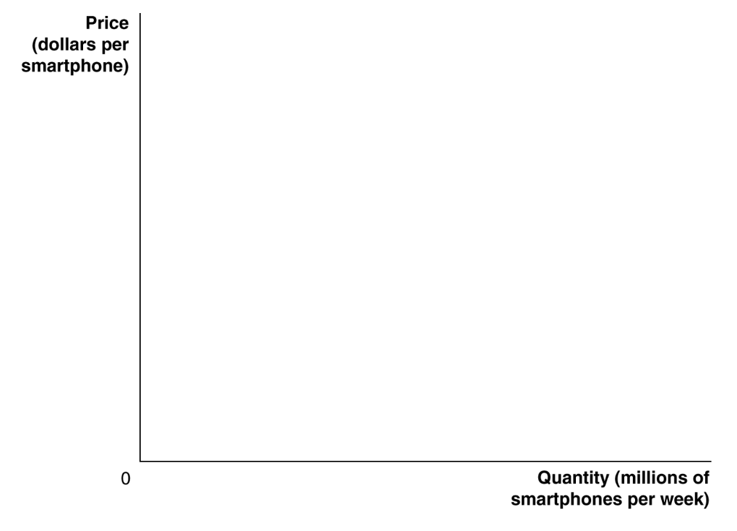
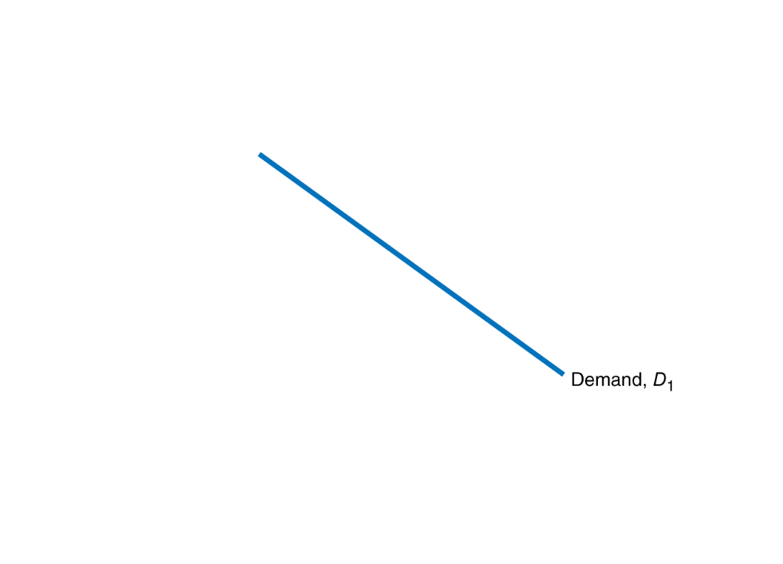
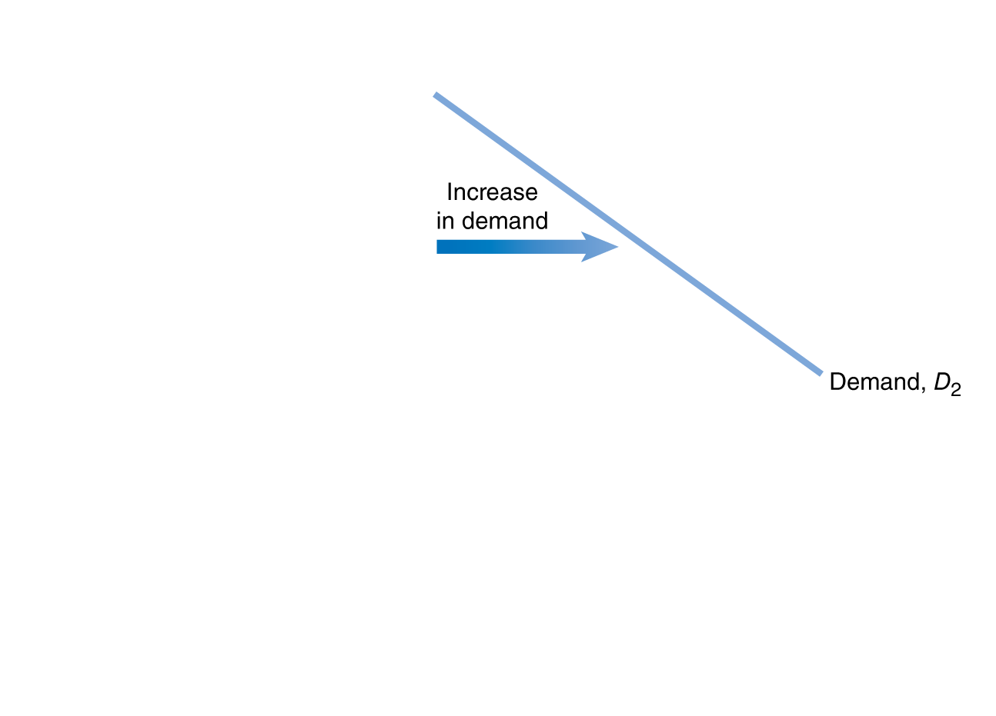
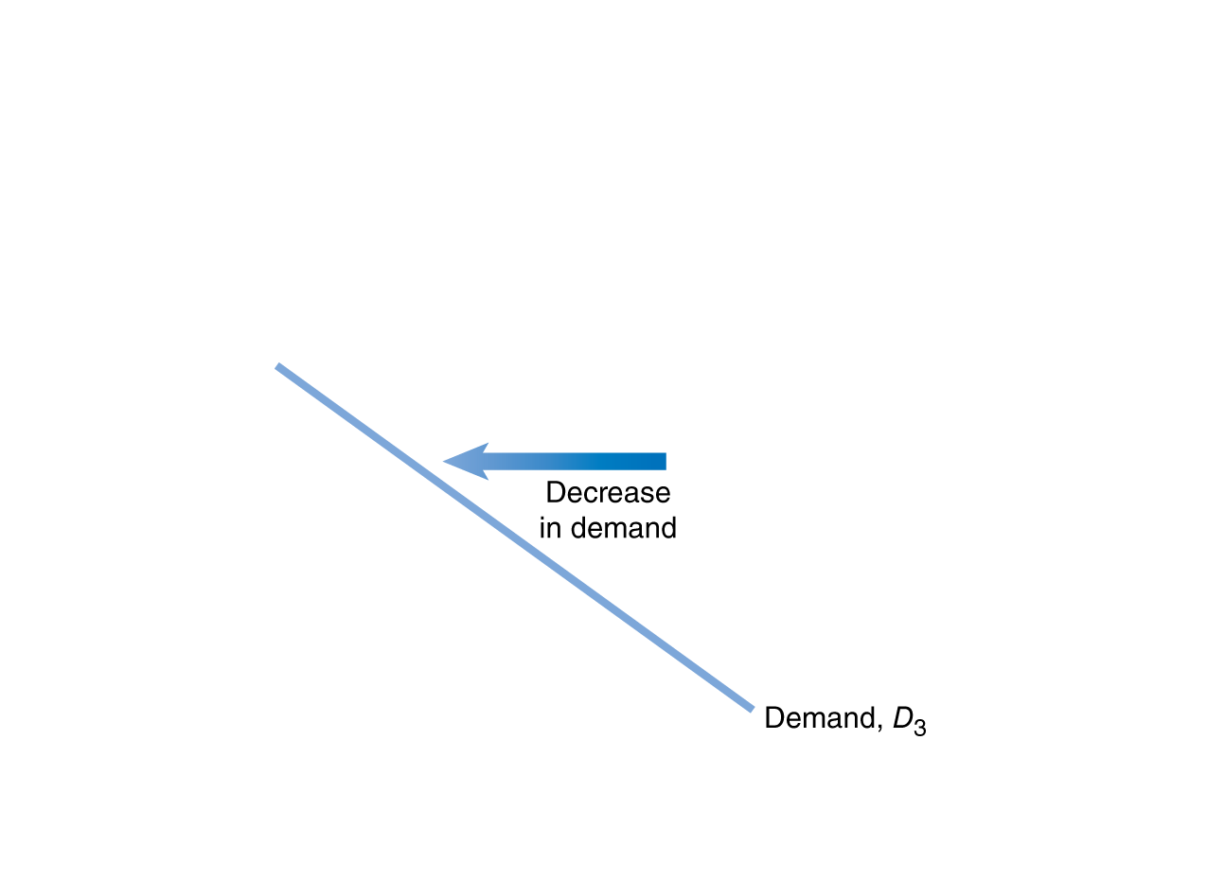
Increase and Decrease in Demand
A change in something other than price:
→Shift in demand
A shift to the right (D₁ to D₂) is an increase in demand.
A shift to the left (D₁ to D₃) is a decrease in demand.
Shifting the demand curve
Notes:
When consumers increase the quantity of a product
they want to buy at a given price, the demand
curve shifts to the right, from D1 to D2. When
consumers decrease the quantity of a product they
want to buy at a given price, the demand curve
shifts to the left, from D1 to D3.

Slide 25
Shifts of the Demand Curve
As the demand curve shifts, the quantity demanded changes at every possible price.
P₁
Q₂ Q₁ Q₃
Shifting the demand curve

Slide 26
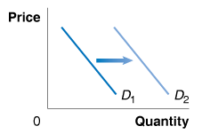
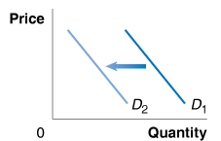
Change in Income of consumers
Normal good: A good for which the demand increases as income rises, and decreases as income falls.
Inferior good: A good for which the demand decreases as income rises, and increases as income falls.
Effect of increase in income, if good is normal
Effect of increase in income, if good is inferior

Slide 27
Change in the Price of Related Goods
Substitutes: Goods and services that can be used for the same purpose.
Complements: Goods and services that are used together.
Effect on demand for Big Macs, if price of Whopper increases
Effect on demand for Big Macs, if price of McDonald’s fries increases
Other sources: Change in tastes, change in demographics

Slide 28
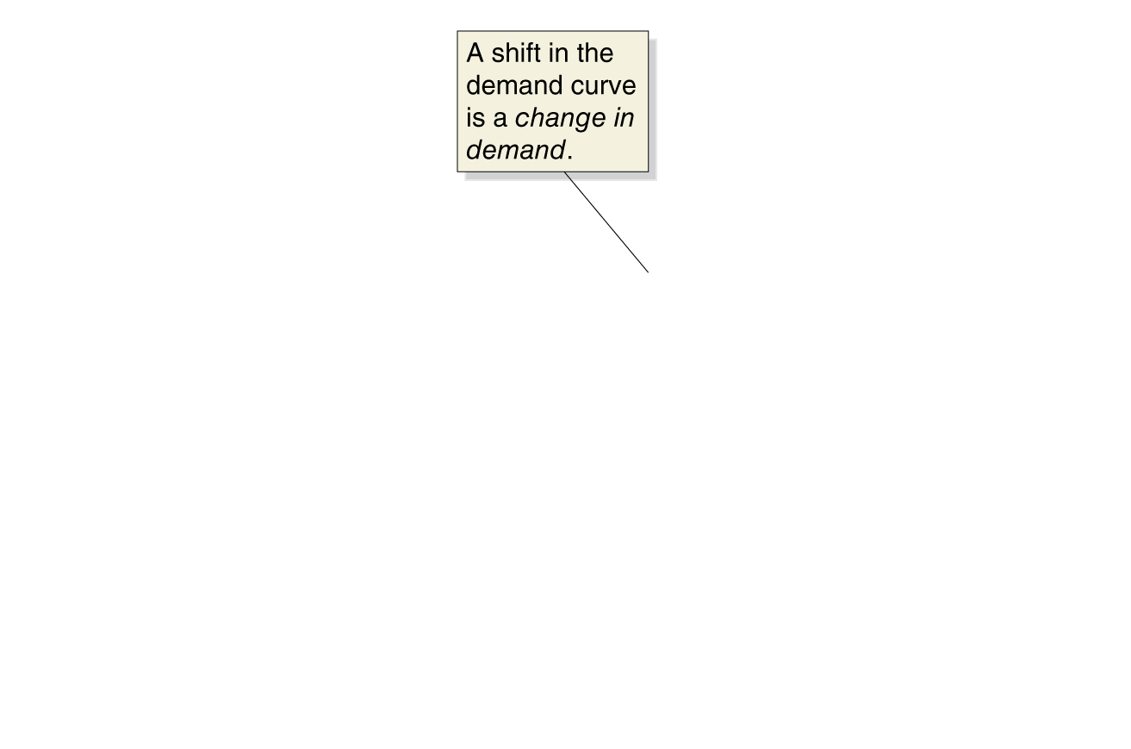
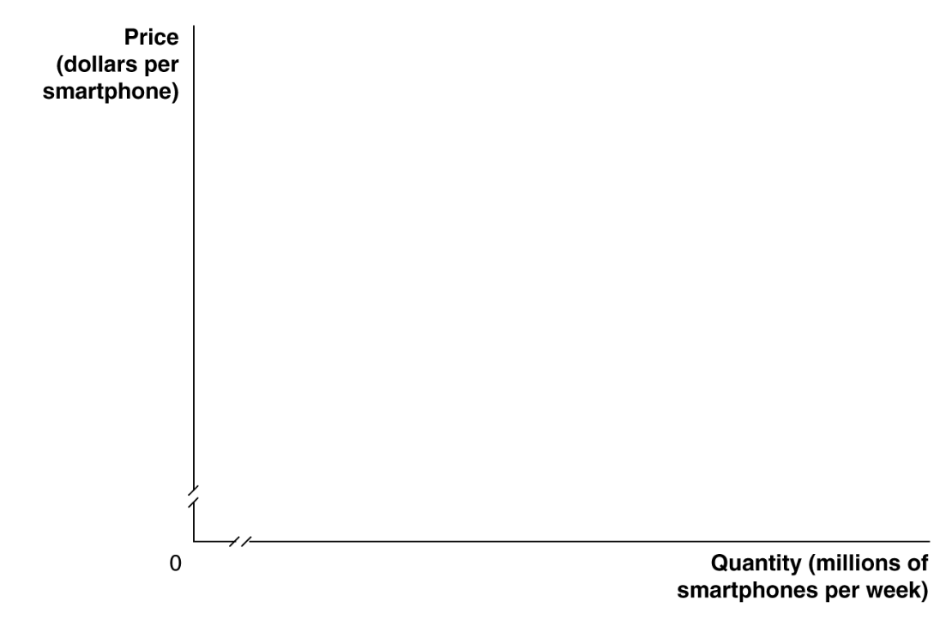
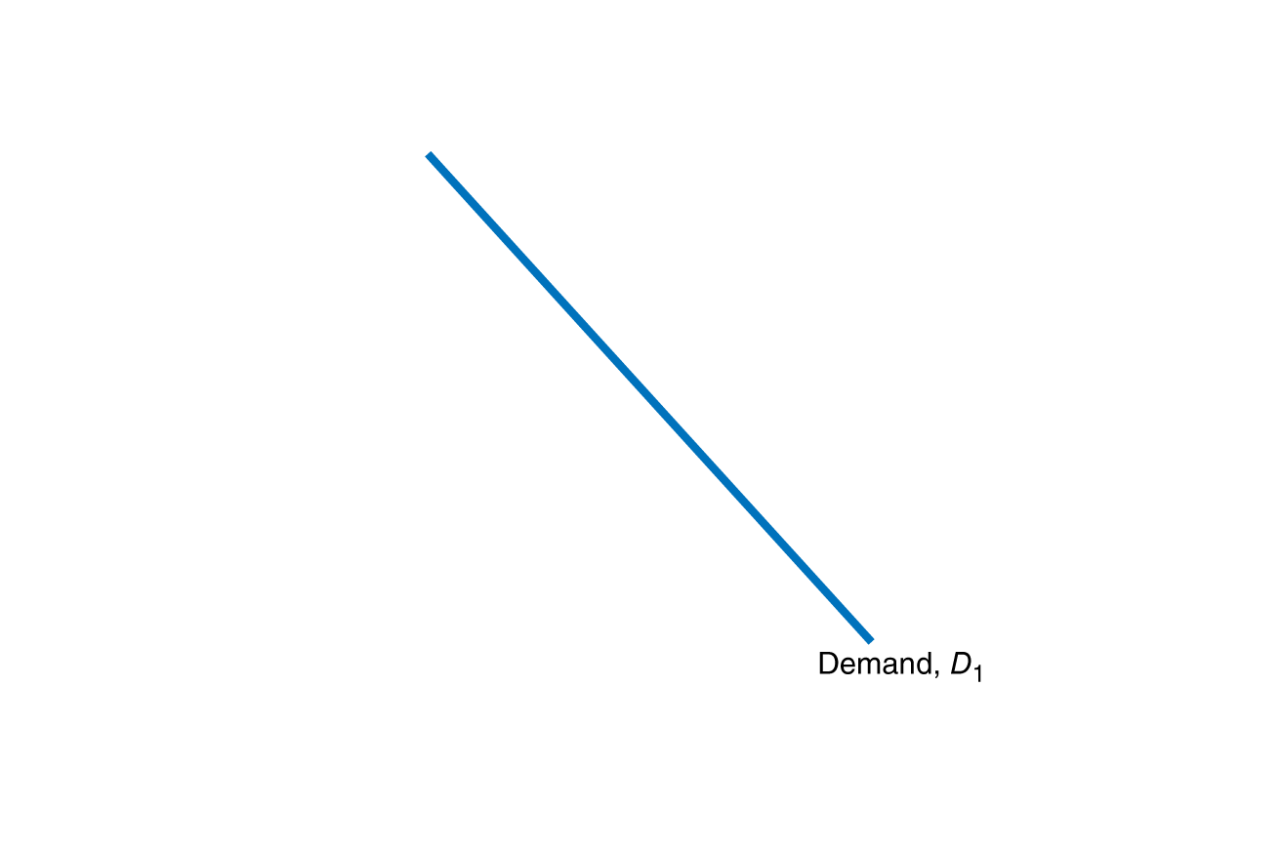
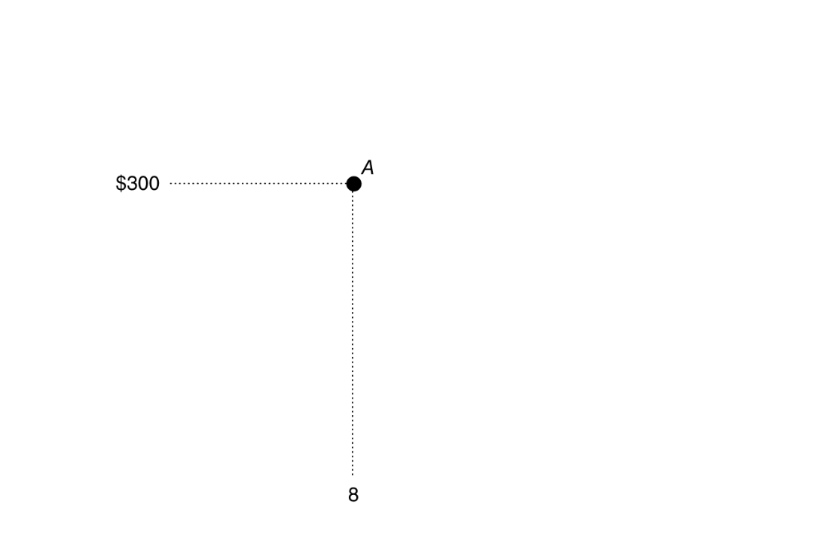
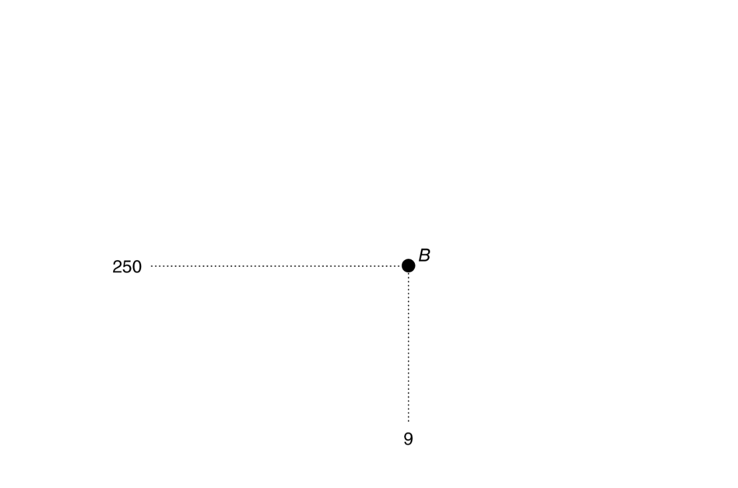

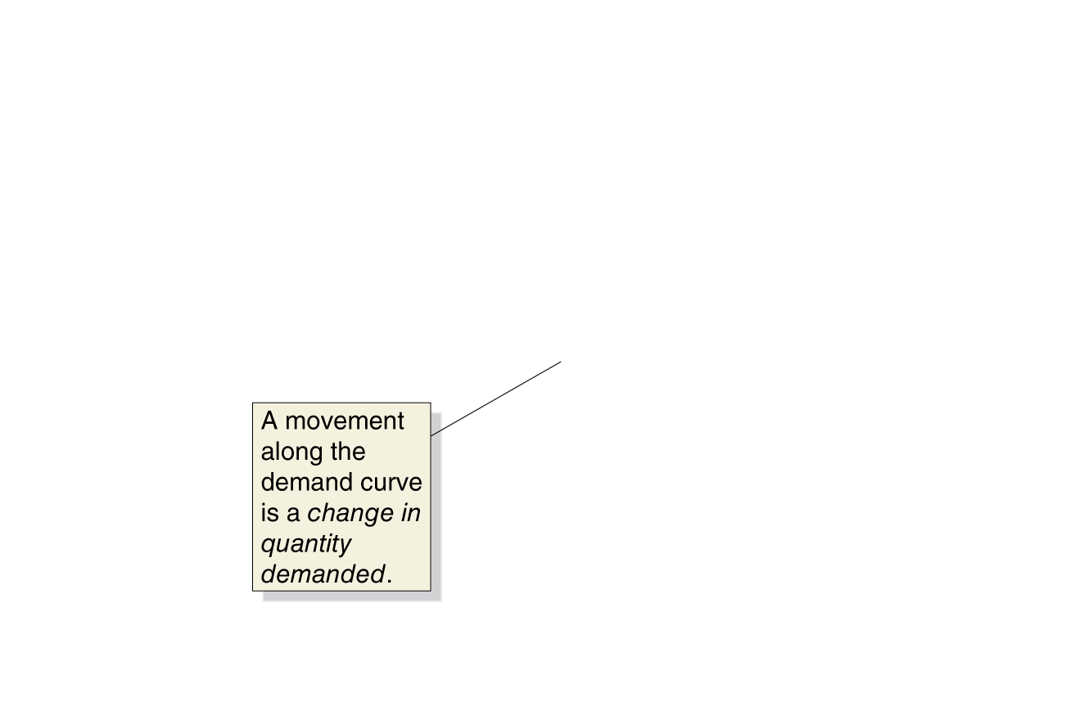
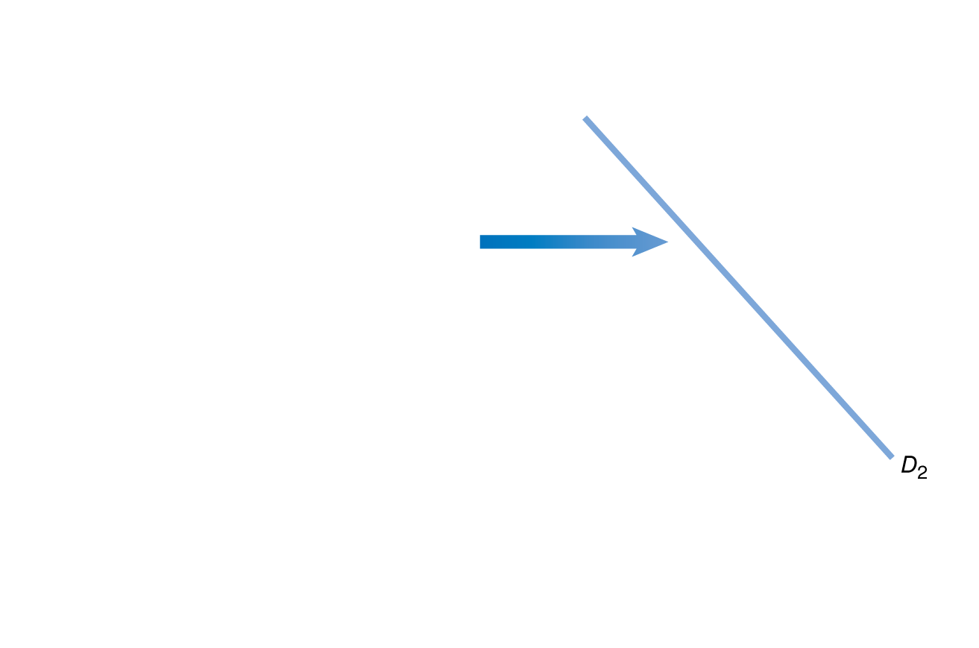
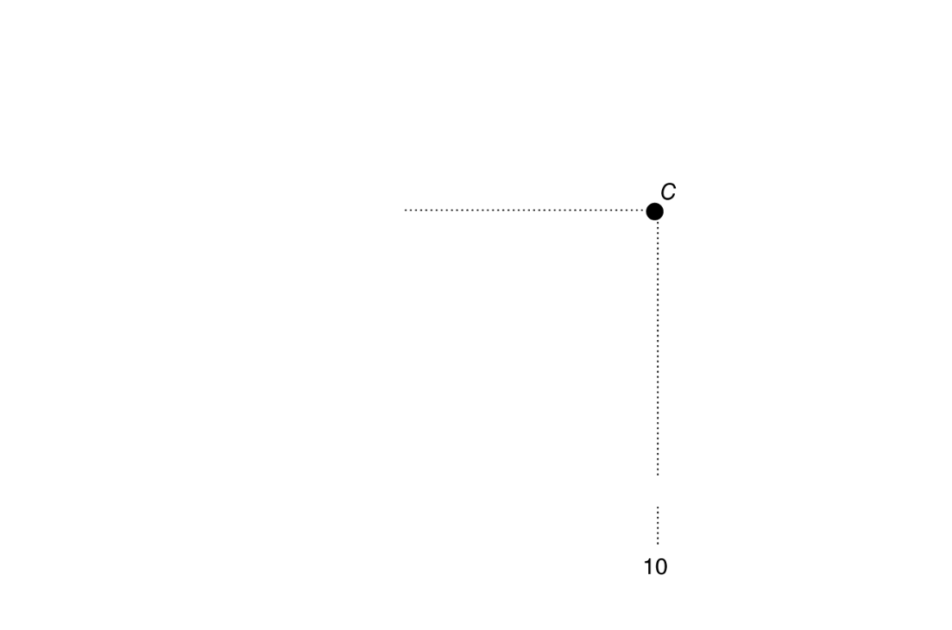
Change in Demand vs. Change in Quantity Demanded
A change in the price of the product causes a movement along the demand curve.
This is a change in quantity demanded.
Any other change causes the entire demand curve to shift.
This is a change in demand.
A change in demand versus a change in quantity demanded
Notes:
If the price of smartphones falls from $300
to $250, the result will be a movement
along the demand curve from point A to
point B—an increase in quantity demanded
from 8 million to 9 million. If consumers’
incomes increase, or if another factor
changes that makes consumers want more
of the product at every price, the demand
curve will shift to the right—an increase
in demand. In this case, the increase in demand
from D1 to D2 causes the quantity of
smartphones demanded at a price of $300
to increase from 8 million at point A to
10 million at point C.

